Slide 1
EXPOSURES TO AVOID IN PREGNANCY
PATRICK DUFF, M.D.

Slide 2
POWER OF THE M.D.

Slide 3
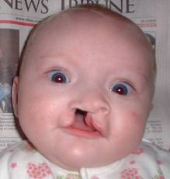
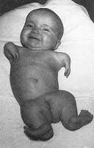
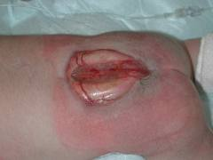
POTENTIAL FOR HARM
Thalidomide
Topiramate
Valproic acid

Slide 4
MECHANISMS OF PLACENTAL TRANSFER
Simple diffusion
Facilitated diffusion
Active transport
Pinocytosis

Slide 5
POSSIBLE TERATOGENIC EFFECTS
Anatomic abnormality
Impaired growth

Slide 6
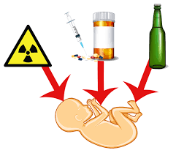
TYPES OF TERATOGENS
Medications
Thalidomide
Environmental agents
Irradiation
Heat
Chemicals
Smoking
Microorganisms
Maternal diabetes

Slide 7
TRIMESTER OF GREATEST FETAL VULNERABILITY

Slide 8
MOST LIKELY ORGAN SYSTEMS AFFECTED

Slide 9
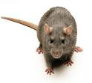
ANIMAL MODELS TO ASSESS TERATOGENECITY

Slide 10
ORIGINAL FDA CLASSIFICATION OF DRUGS IN PREGNANCY
FDA CLASS | EXPLANATION
A | No harm
B | No harm but limited human studies
C | Animal studies suggest risk
D | Harmful
X | Absolutely contraindicated
Discontinued in the summer of 2015

Slide 11
ACE INHIBITORS AND ARBs
Most likely adverse fetal effect?
Is the effect reversible?
Is there a safe period in pregnancy to use these drugs?

Slide 12
BETA BLOCKERS
Usual indications?
Adverse fetal effects?

Slide 13
CARBEMAZEPINE
Possible indications in the mother?
Most likely harmful effects in the baby?

Slide 14
COUMADIN
Most likely adverse effect in the fetus?
Alternative agents for anticoagulation in pregnancy?

Slide 15
DOLUTEGRAVIR
What is the usual indication for use of this drug?
What is the mechanism of action of this drug?
What is the newly described fetal anomaly associated with use of this drug in early pregnancy?

Slide 16
HEAT
How does the fetus dissipate heat?
Critical time of exposure?
Most likely adverse fetal effect?

Slide 17
ISOTRETINOIN
Most likely prescriber?
Indication?
Adverse fetal effects?

Slide 18
LITHIUM
Usual indication in the mother?
Most likely harmful effect in the fetus?

Slide 19
METHAMPHETAMINE
Most likely adverse fetal effect?
Most likely adverse neonatal effect?
Effect on breast feeding?

Slide 20
NARCOTICS
Two most likely sources of exposure?
Most likely adverse fetal effects?
Most likely adverse neonatal effect?

Slide 21
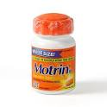
NSAIDS
Usual indications?
Adverse maternal effects?
Adverse fetal effects?

Slide 22
PHENYTOIN
Usual indication?
Most likely adverse fetal effects?

Slide 23
QUINOLONES
Usual indications?
Most likely harmful effect in the fetus?
Acceptable indications in pregnancy?

Slide 24
RADIATION
Dose threshold?
Most likely adverse fetal effect?

Slide 25
SSRIs
Usual indication?
Most dangerous of the SSRIs in pregnancy?
Most likely adverse fetal effect?

Slide 26
TETRACYCLINE/DOXYCYCLINE
Possible harmful effect in the mother?
Most likely adverse effect in the fetus?

Slide 27
THALIDOMIDE
Original indication?
Adverse fetal effects?

Slide 28
TOBACCO
Most likely adverse fetal effects?
Most serious maternal complication?

Slide 29
TOPIRAMATE
Possible indications?
Newly described adverse fetal effect?

Slide 30
TRIMETHOPRIM-SULFAMETHOXAZOLE
Most likely adverse fetal effect with first trimester exposure?
Potential neonatal effect with exposure just prior to delivery?

Slide 31
VALPROIC ACID
Usual indications?
Most likely adverse fetal effect?

Slide 32
ZIDOVUDINE
Most common indication ?
Most likely adverse fetal effect ?

Slide 33
MICROORGANISMS
MICROBE | TERATOGENIC EFFECTS
Rubella
Varicella
CMV

Slide 34
MICROORGANISMS
MICROBE | TERATOGENIC EFFECTS
Parvovirus
Toxoplasmosis
Zika virus

Slide 35
EXPOSURE TO TERATOGENS CONCLUSIONS
Think carefully before prescribing any drug in pregnancy, especially in the first trimester
If you are unsure about the safety of a drug, ask for consultation from your obstetric colleague

